Slide 1
Autonomous Control for Driverless Car
B.Tech Project End-Term Presentation
Submitted by: Supervised by:
Akash Pardasani Prof. Sunil Jha
Dhruv Talwar

Slide 2
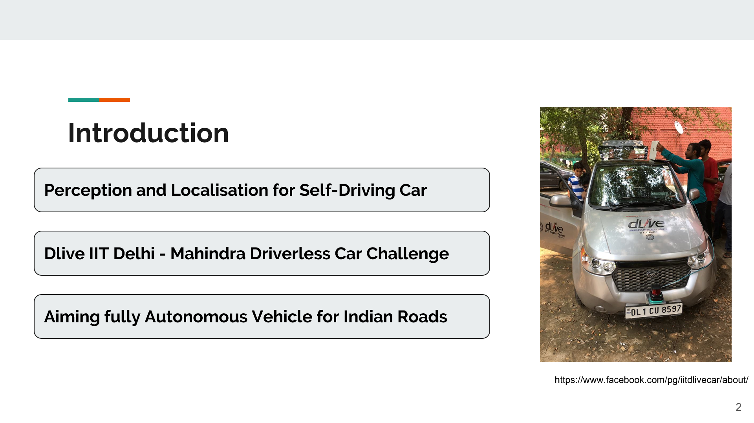

Slide 3
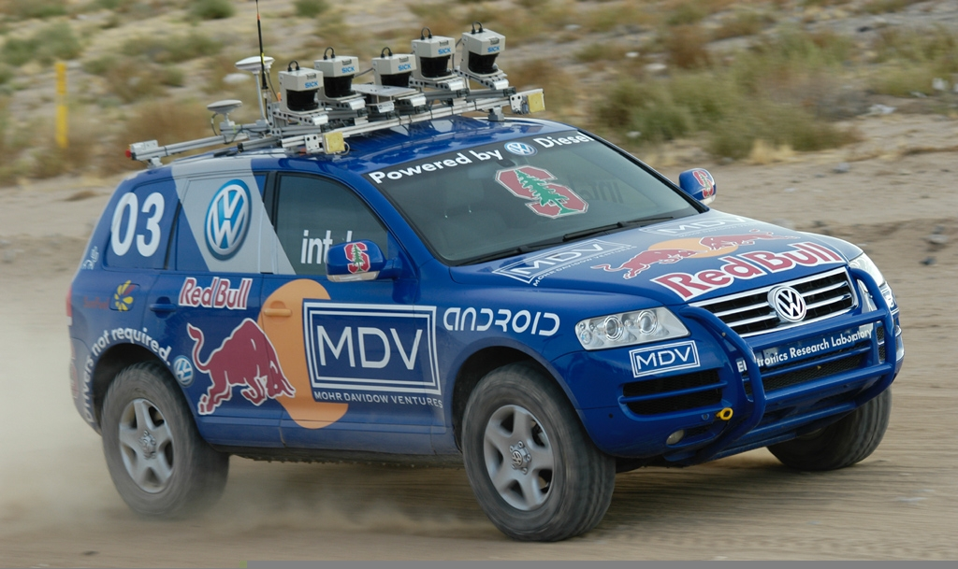

Literature Survey
Environment & Toolkits DARPA Challenge Reports
https://commons.wikimedia.org/wiki/File:Ros_logo.svg
https://news.stanford.edu/news/stanleyfinish.html
3D Mapping Techniques Survey
Cartographer Documentation
Survey of the Technical Reports
Insights into the Modular Approach

Slide 4
Literature Survey
LIDAR for Autonomous Cars
Localisation
Dense 3D Map Generation
Particle Filter based Localization
Local Position Estimation
Velodyne VLP-16 Documentation
Particle filter based AMCL approach
Cartographer Submap Matching
Offline & Online Localisation
Adaptation to Urban Areas

Slide 5
Project Objectives
Dense 3D Map Generation for IIT Delhi Campus using LIDAR
Accurate Localization using LIDAR
Qt based GUI for Real-time Analysis of Sensor Information

Slide 6
Methodology
Familiarization with hardware, ROS, Gazebo, Cartographer and other toolkits
Implementation and Analysis of Vision based Local Position Estimation Method
Collection of Rosbag Data from Test Run and Generation of 3D Map using Cartographer
Development of Qt based sensor information analysis GUI
Adopt LIDAR based approach
Particle based Localization

Slide 7
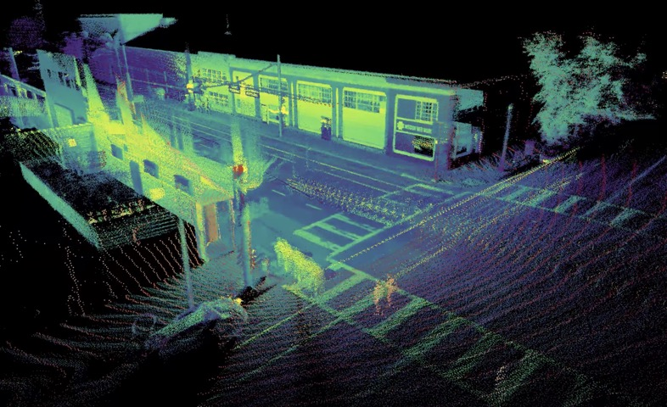
Relevant Theory
Google Cartographer and LIDAR 3D Map
Real time SLAM in 2D and 3D
Across multiple sensor configurations
Generation of Costmaps
Generation of Point Cloud Data
Localisation Only mode as well
https://www.spar3d.com/news/lidar/ouster-starts-2019-with-a-new-18k-128-channel-lidar-and-big-benefits-for-mapping/

Slide 8
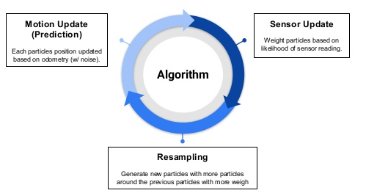
Relevant Theory
AMCL Algorithm
Basic Principle
Start with lots of random samples
Weight each with probability based on sensor reading
Given an action use importance weighting to select from the old particles
Probabilistically create new particle given action and motion model
https://www.slideshare.net/6RiverSystems/robot-localization-with-amcl

Slide 9
Experiments and Results
Path Map Generation- Generation of Maps to show the trajectory of the car in the campus.
3D Map Generation- Generation of the 3D Map on the IIT Delhi Campus
Grayscale Maps- Converting the maps into ROS compatible map
AMCL Localization- Obtained the position and orientation of the car wrt the map frame
Cartographer Localization- Comparison of the actual trajectory and the estimated trajectory
2D Lidar Based Road Lane Detection- Intensity based road segmentation
Development of Qt based GUI for sensor visualization

Slide 10
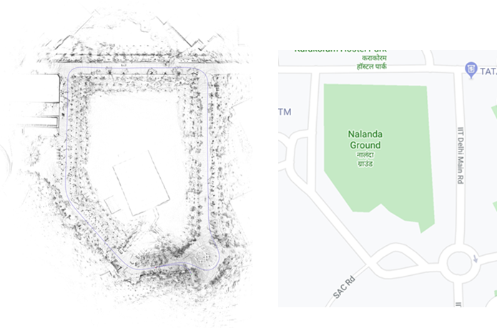
Path Map Generation
Blue line denotes the trajectory followed by the car, while collecting the 3D lidar data for map generation.
Figure 1: Cartographer Map of IIT Delhi, SAC Circle
Figure 2: Google Map of IIT Delhi, SAC circle

Slide 11
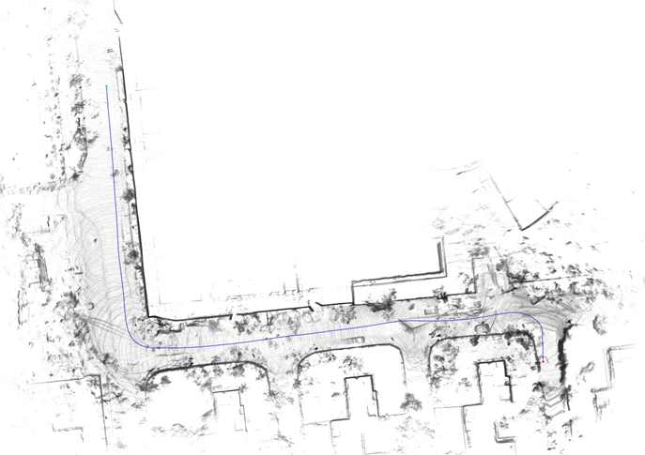
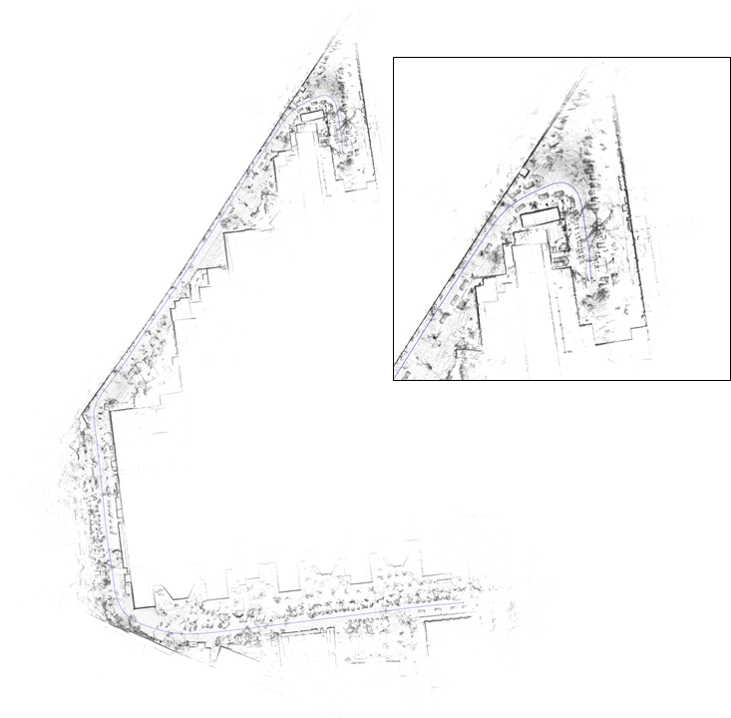
Path Map Generation
Figure 3 : Cartographer Map, IIT Delhi, New Campus Area
Figure 4 : Cartographer Map IIT Delhi Campus, Blocks Area

Slide 12
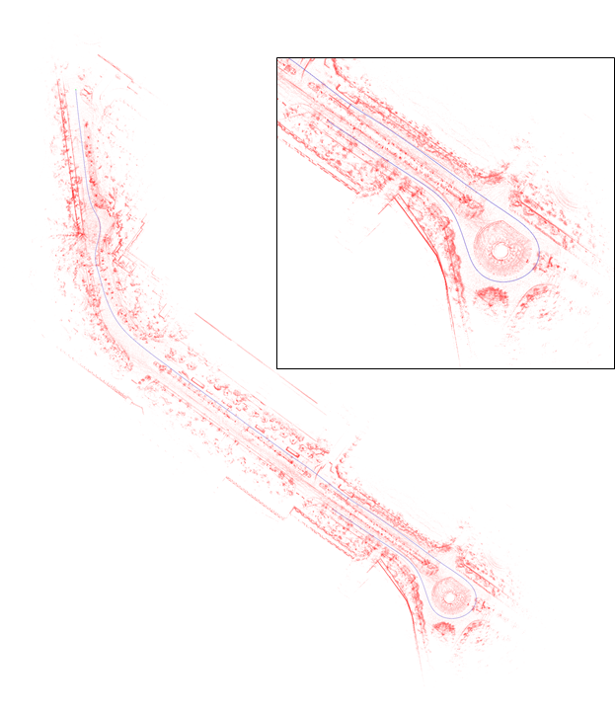
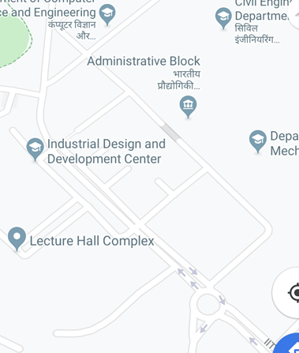
Path Map Generation
Figure 5: Cartographer Map, IIT Delhi Campus, Himadi Circle
Figure 6: Google Map, IIT Delhi Campus, Himadi Circle

Slide 13
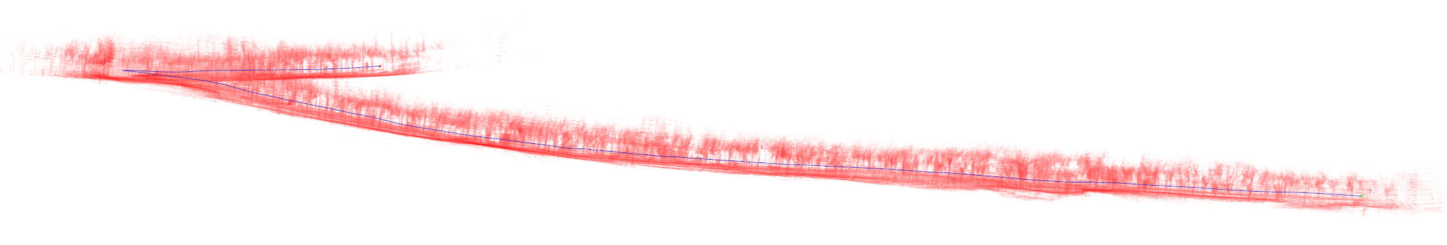
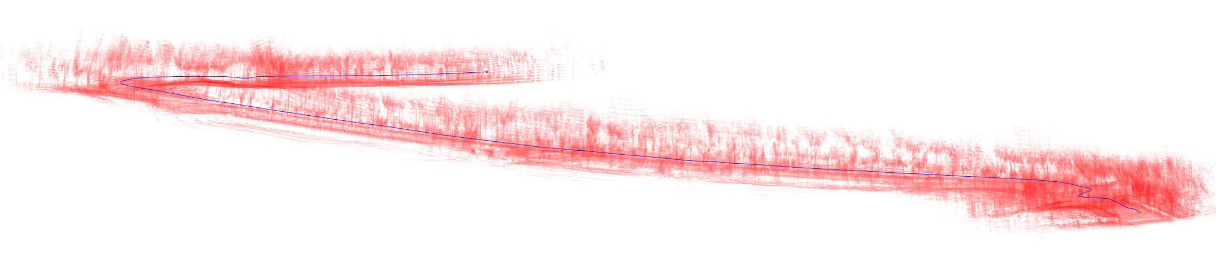
Projection Maps
Figure 8: Cartographer Map, XZ orientation
Figure 9 : Cartographer Map, YZ orientation

Slide 14
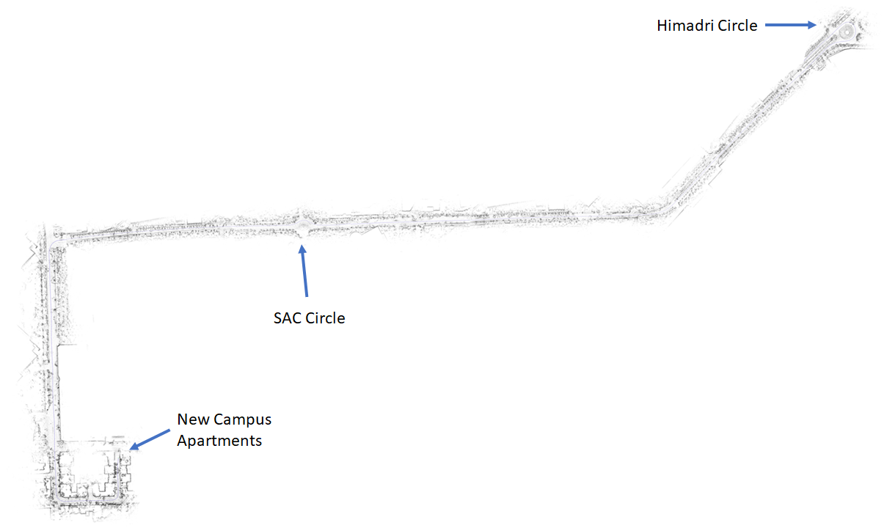
Complete Map of IIT Main road
Figure 7 : Cartographer Map, IIT Delhi Campus

Slide 15
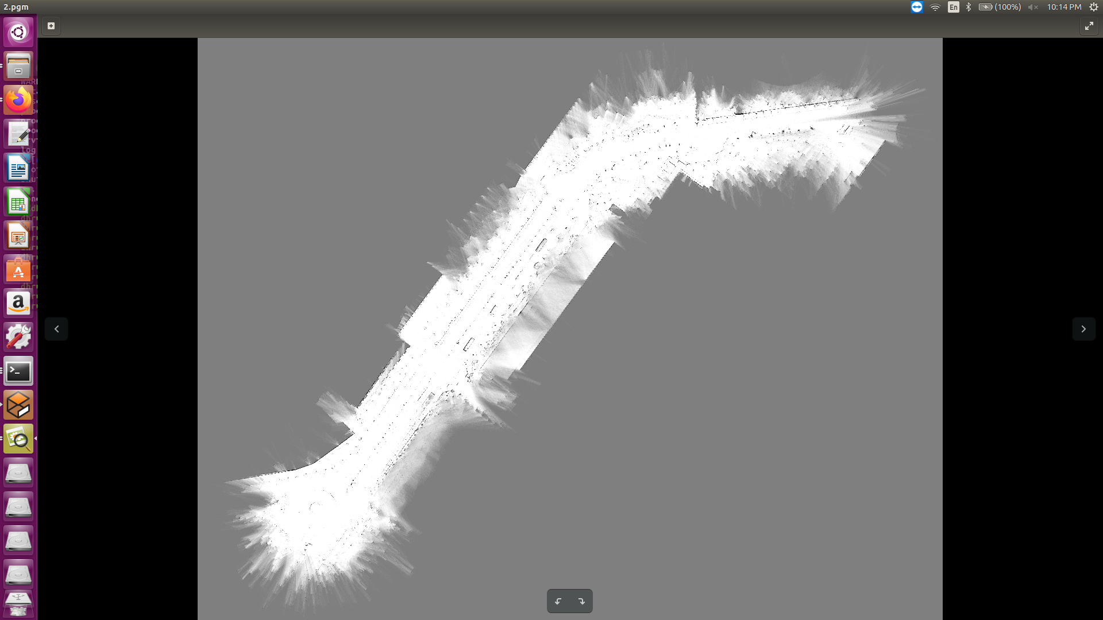
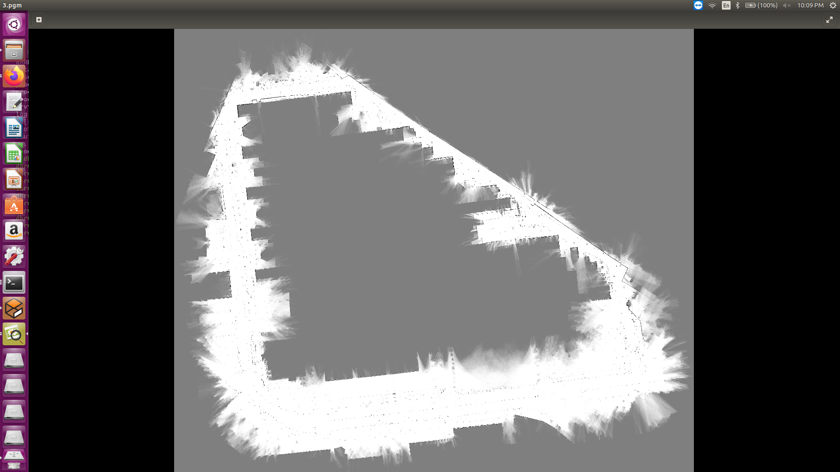
ROS Map Generation
White Pixels represent free cells
Black pixels represent occupied cells
Gray pixels are in unknown state
Figure 10: ROS Map showing IIT Delhi campus, Main Road
Figure 11: ROS Map showing IIT Delhi Campus, Blocks Area

Slide 16
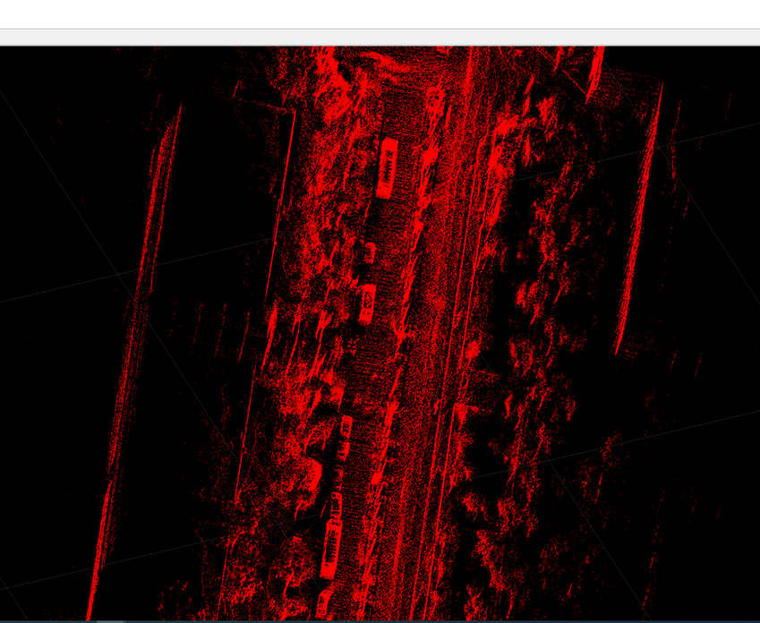
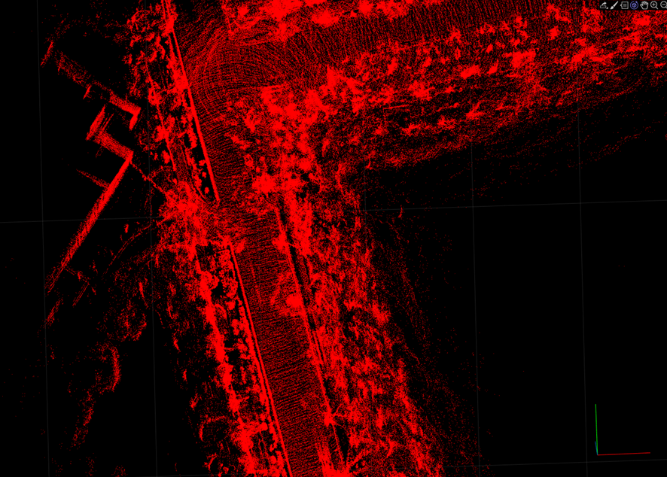
3D Map Generation
3D Point Map Visualized in MATLAB
Figure 12: 3D point cloud Map showing obstacles eg cars.
Figure 13: 3D Point cloud Map showing IIT Delhi campus, Main Road

Slide 17
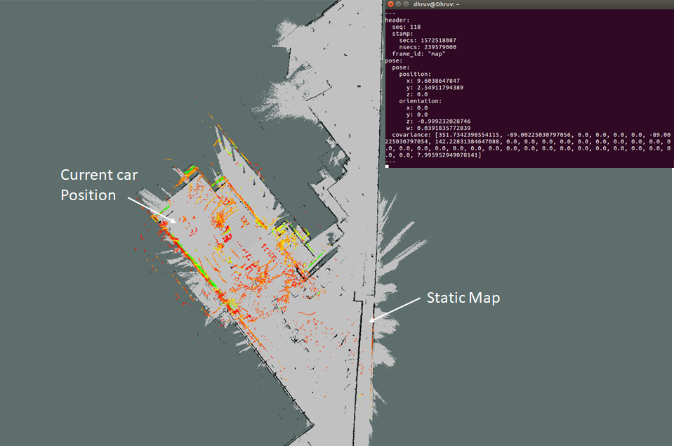
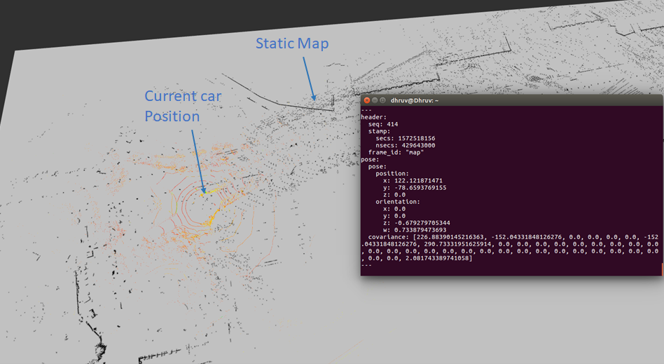
AMCL Localization
Figure 14: Pose of the car obtained from AMCL algorithm in map A
Figure 15: Pose of the car obtained from AMCL algorithm in map B

Slide 18
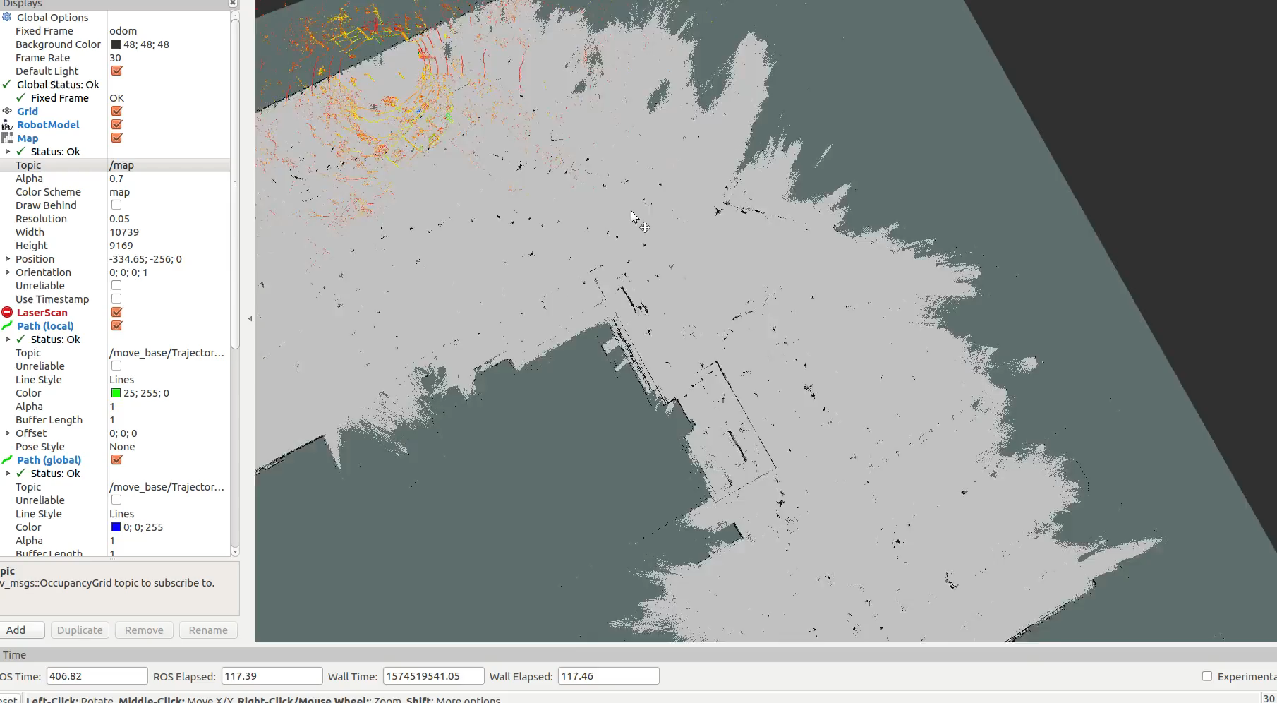
AMCL Localization

Slide 19
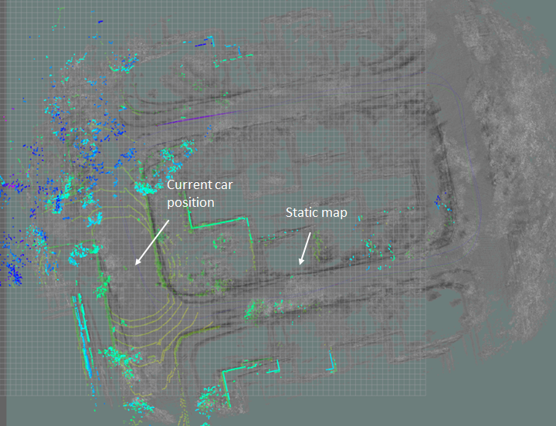
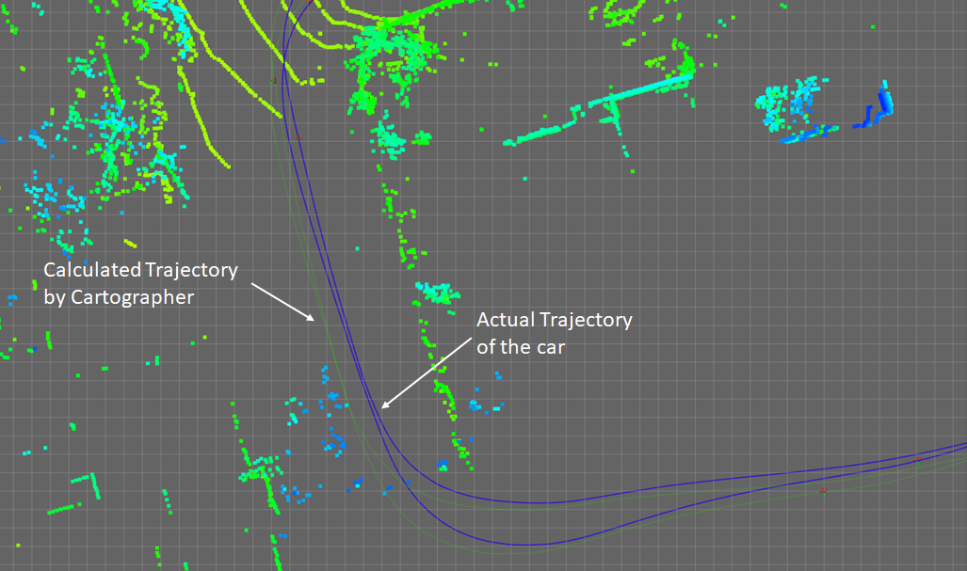
Cartographer Based Localization
Figure 16: Car’s position in static Cartographer map in Rviz (IIT Delhi, New Campus Area)
Figure 17: Comparison of Actual Trajectory and Calculated Trajectory of the car in Rviz

Slide 20
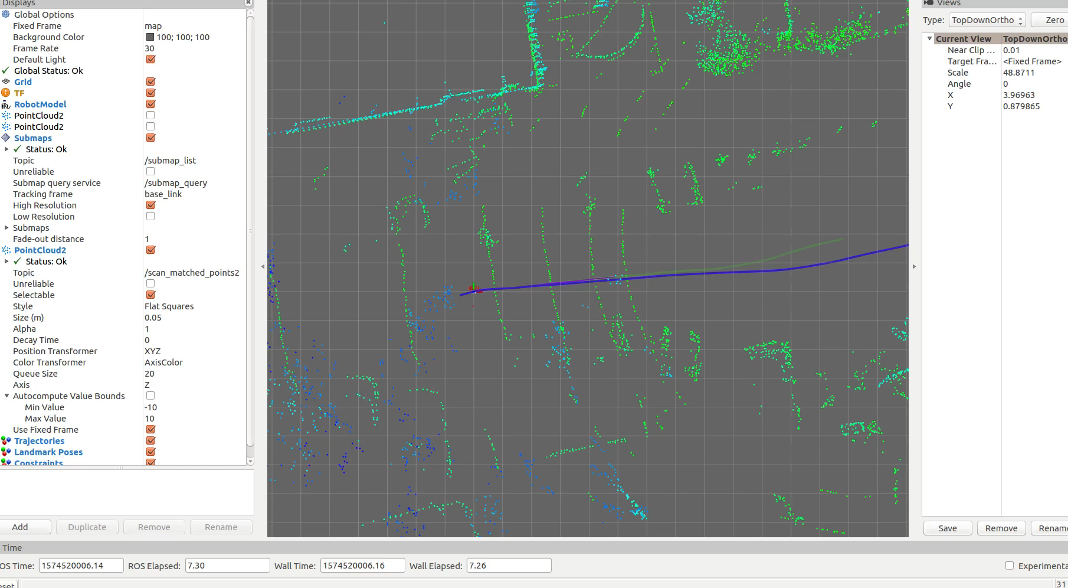
Cartographer Based Localization

Slide 21
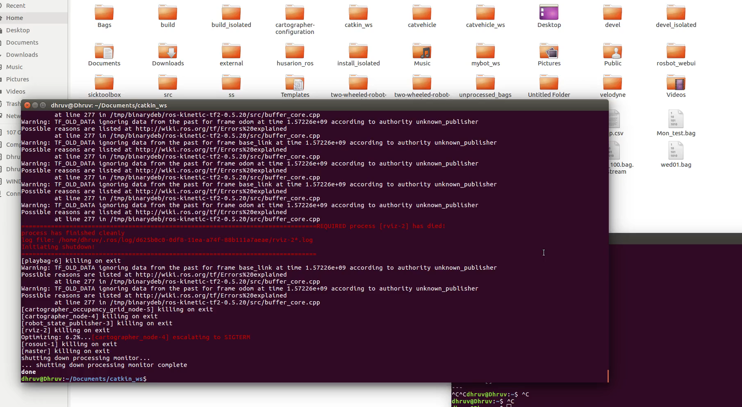
Cartographer Based Localization

Slide 22
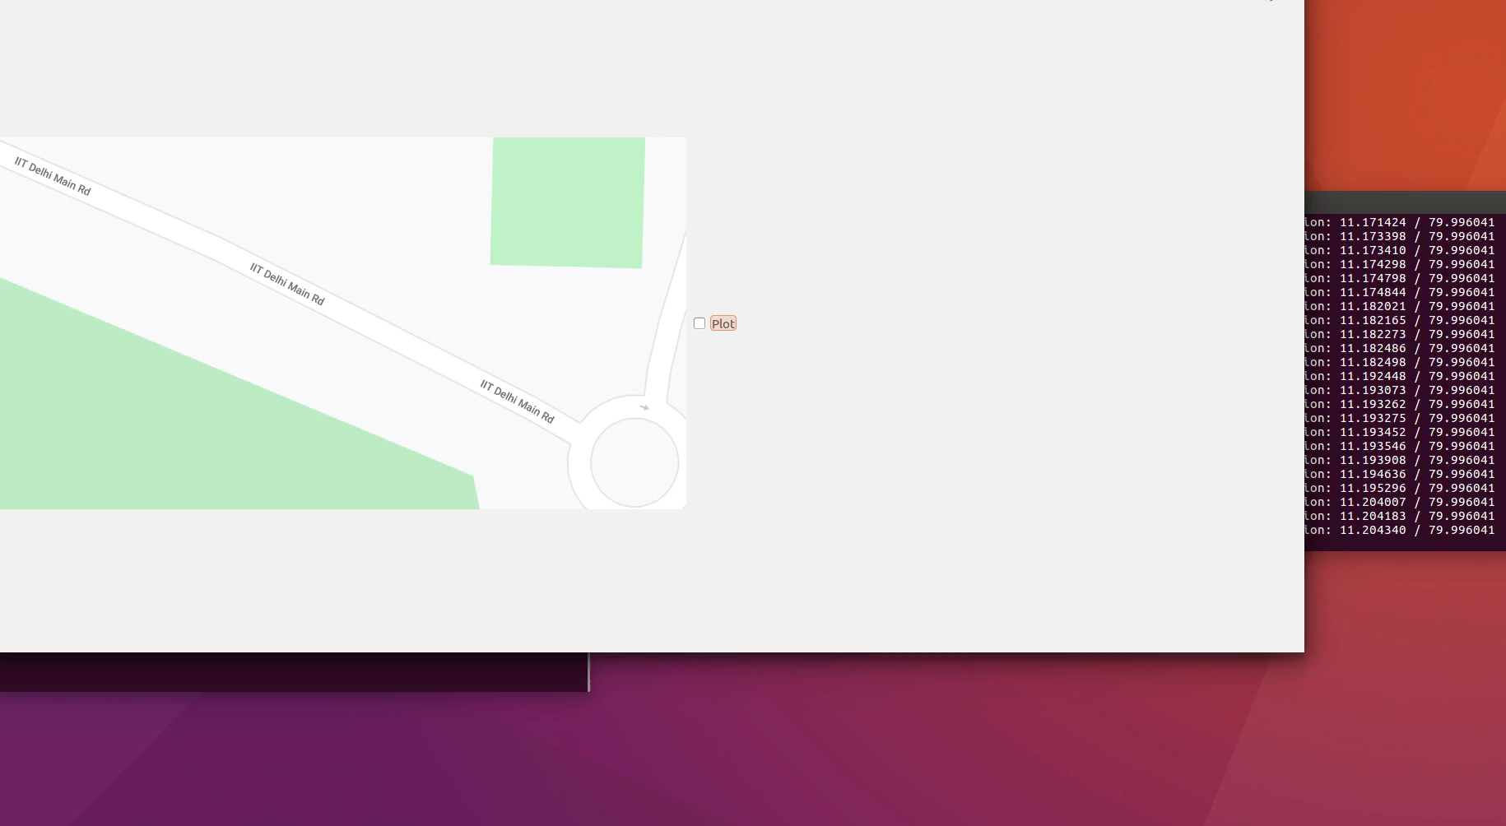
Qt Based Sensor Analysis GUI

Slide 23
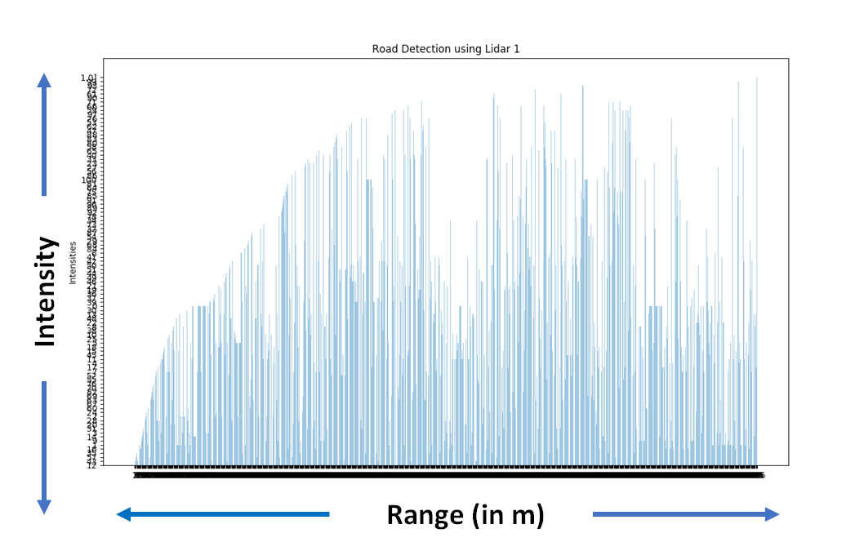
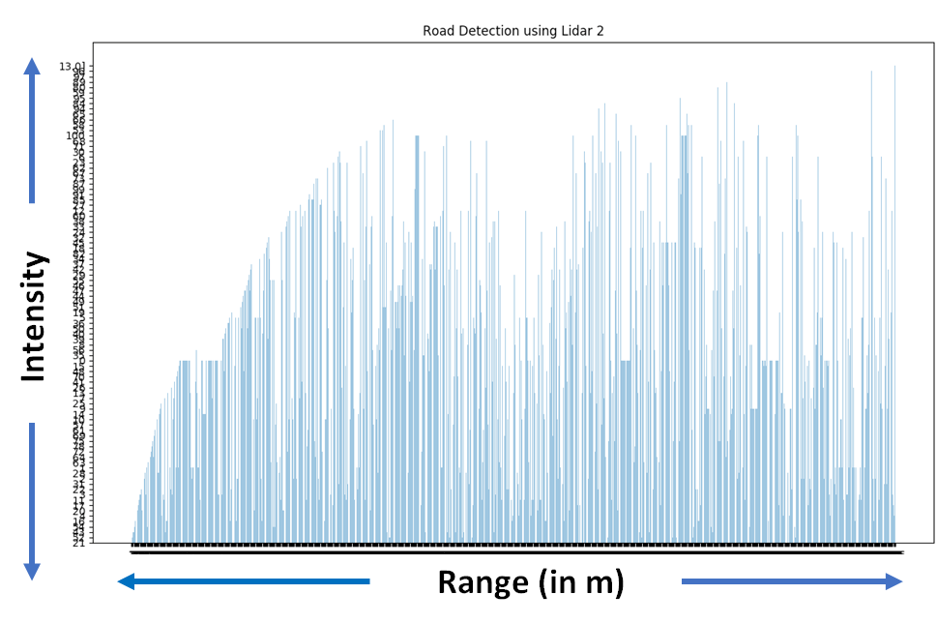
2D Lidar Based Lane Detection
Figure 18: 2D Lidar recorded intensity across its range (Bagfile Time = 9.2 seconds)
Figure 19: 2D Lidar recorded intensity across its range (Bagfile Time = 16.4 seconds)

Slide 24
Conclusions and Further Work
3D Maps from Google Cartographer should suffice as tools for accurate localisation
Further tuning of AMCL and Cartographer Localisation parameters for improved performance
Inconclusive results from 2D Lidar based Road Lane Detection
Modular Qt based GUI setup done with easily additive information from other sensors
Will be continuing the project as B.Tech Project-II next semester
Will be improving localisation accuracy as well as explore platforms like Nvidia and MATLAB

